Slide 1
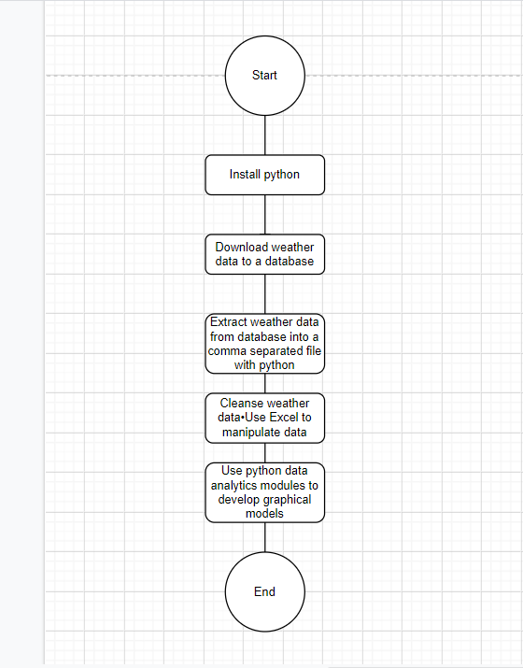
Flowchart
Include the following processes:
Install python
Download weather data to a database.
Extract weather data from database into a comma separated file with python
Cleanse weather data
Use Excel to manipulate data
Use python data analytics modules to develop graphical models

Slide 2
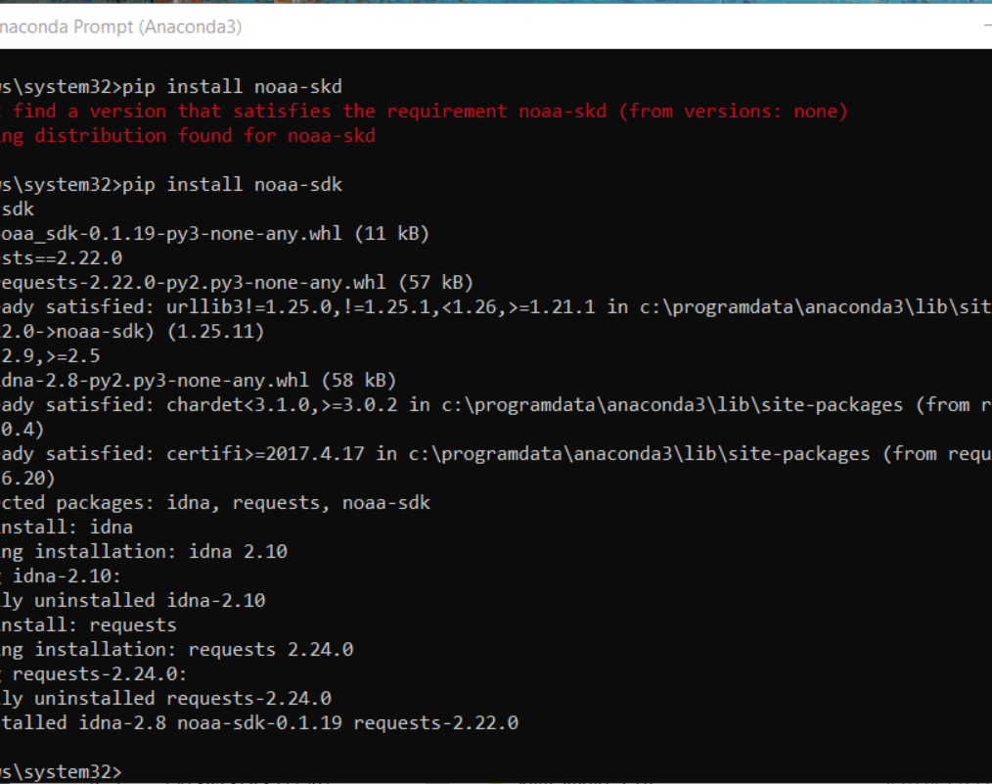
Software Inventory (Screenshots)
Include screenshot of NOAA-SDK library installed
Ensure result "Successfully installed noaa-sdk" of pip install command is visible in your screenshot.

